Slide 1
Final Engagement
Attack, Defense & Analysis of a Vulnerable Network
Juan, Melvin, Joseph O, Francis, Mike C

Slide 2
Table of Contents
This document contains the following resources:
Network Topology & Critical Vulnerabilities
Alerts Implemented
Hardening
Implementing Patches

Slide 3

Network Topology
& Critical Vulnerabilities
3

Slide 4
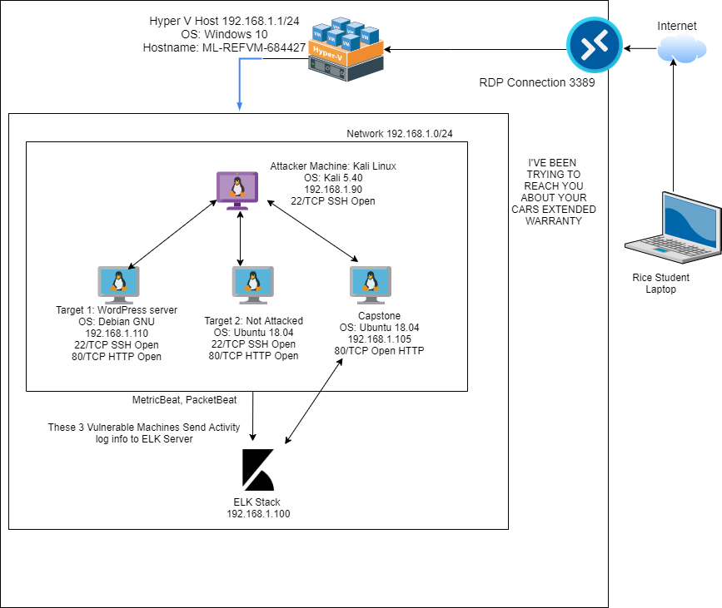
Network Topology
Network
Address Range:
192.168.1.0/24
Netmask: 255.255.255.0
Gateway: 192.168.1.1
Machines
IPv4: 192.168.1.90
OS: Debian Kali 5.4.0
Hostname: Kali
IPv4: 192.168.1.110
OS: Debian GNU/Linux 8
Hostname: Target 1
IPv4: 192.168.1.105
OS: Ubuntu 18.04
Hostname: Target 2
IPv4: 192.168.1.105
OS: Ubuntu 18.04
Hostname: Capstone
IPv4: 192.168.1.100
OS: Ubuntu 18.04
Hostname: ELK

Slide 5
Critical Vulnerabilities: Target 1
Our assessment uncovered the following critical vulnerabilities in Target 1.
Vulnerability | Description | Impact
Poorly Configured SSH Port | Performed an nmap scan of target host 1 | Since user michael had a password implemented, we were able to gain access
Wordpress enumeration | Performed a wpscan enumeration | We discovered users: michael & steven
Weak Password Implementation | After discovering users was able to perform a hydra brute force attack using michael’s login | michaels password is michael
No File Security Permission Implementation | Plaintext password in wp-config.php | We were able to login to mysql using R@v3nSecurity

Slide 6
Critical Vulnerabilities: Target 1 (Continued)
Our assessment uncovered the following critical vulnerabilities in Target 1.
Vulnerability | Description | Impact
Use of weak password salted hashes | salted password used a weak hash value that only has 32 | we were able to crack the weak using john the ripper, after execution we received pink84
Python root escalation | Used sudo -l to gain information needed to perform escalation sudo python -c ‘import pty;pty.spawn(“bin/bash”)’ | after discovery of stevens password; we were able to ssh with his credentials and perform a python root escalation

Slide 7
Alerts Implemented
7

Slide 8
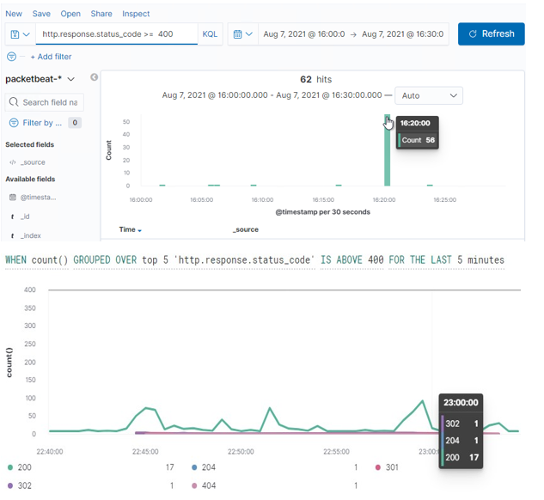
Excessive HTTP Errors
Summarize the following:
Metric = WHEN counts ( ) GROUPED OVER top 5 `http.response.status_code`
Threshold = IS ABOVE 400 FOR THE LAST 5 minutes

Slide 9
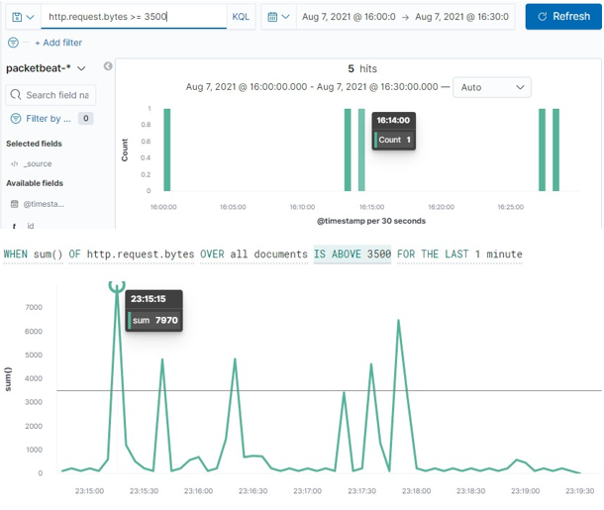
HTTP Request Size Monitor
Summarize the following:
Metric = WHEN sum ( ) of `http.request.bytes` OVER all documents
Threshold = IS ABOVE 3500 FOR THE LAST 1 minute

Slide 10
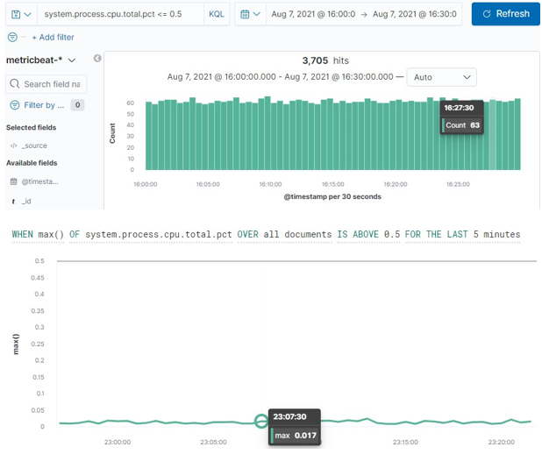
CPU Usage Monitor
Summarize the following:
Metric = WHEN max ( ) OF `system.process.cpu.total.pct` OVER all documents
Threshold = IS ABOVE 0.5 FOR THE LAST 5 minutes

Slide 11
Hardening
11

Slide 12
Hardening Against Open Port 22 SSH Vulnerability on Target 1
Changing the port and using a non-standard port is to avoid being seen by casual scans. Hackers looking for any open SSH servers will look for port 22, since by default, SSH listens for incoming connections on that port. If it’s harder to scan for your SSH server, then the chances of being attacked are lower.
To change our port, open our /etc/ssh/sshd_config file and add the following lines:
#Run SSH on a non standard port
Port 2025 #Change me
Then restart the SSHD service by entering one of the following commands to apply the changes:
‘/etc/init.d/sshd restart’ or ‘service sshd restart’

Slide 13
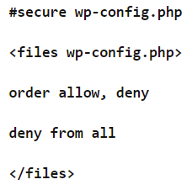
Hardening Against WordPress Configuration and SQL Database Vulnerability on Target 1
Recommended to configure and hash the WordPress database login information to prevent unwanted access to the SQL database.
With the information unhashed and easily accessible, root access to the SQL database and it’s information is easily attained.
Protection through .htcaccess file
Connect your wordpress site to an FTP client (use SFTP or FTPES to encrypt communication between computers & servers) and download the .htcaccess file which can be found in the root directory of the WordPress website.
Open the .htcaccess file using any text editor app.
including the following line: ----------------------->
Update WordPress when new releases come out.

Slide 14
Hardening Against Privilege Escalation on Target 1
Role and permission management of new and existing users is essential to preventing vertical or horizontal escalation of privileges to unauthorized users.
Recommended to set correct file permissions for user accounts, maintain control over assigned roles and permissions for any existing or new user accounts.
Remove sudo access for python from the user.

Slide 15
Hardening Against WordPress XML-RPC Related Vulnerabilities on Target 1
Update WordPress version.
Disable XML-RPC API settings if still enabled (patched after WordPress 3.5.1, as well as post version 3.9.2)
xmlrpc.php can be disabled by plugin function utilizing the following as part of theme functions or in better practice as a plugin:
add_filter( ‘xmlrpc_enabled’, ‘__return_false’ );

Slide 16
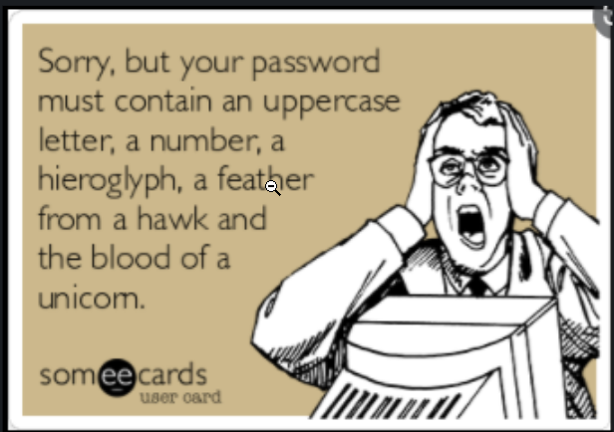
Hardening against Weak passwords
Use Strong and Unique Passwords
Enforce users to add special characters, UPPER, & lower case alphabets; & 0-9.
Enforce password history.
Implement MFA Authentication.
Enforce Policy to change password every 90 days
Don’t use personal information: michael
Generate an SSH Key Pair.

Slide 17
Implementing Patches
17

Slide 18
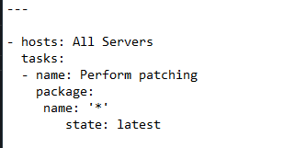
Implementing Patches with Ansible
Playbook Overview
Update packages in Debian server where wordpress is being hosted.

Slide 19


